Slide 1

Netflix Dataset Analysis
Sourav Thakur INTERNSHIP_172663295366ea53f910591

Slide 2

PROBLEM STATEMENT
This project focuses on analyzing Netflix’s content catalog to identify trends in Movies vs. TV Shows, genres, and country-wise contributions over the years (2008–2021). With increasing competition from other OTT platforms, the goal is to uncover content patterns and audience preferences that can guide Netflix in making strategic, data-driven decisions for future content acquisition and production.

Slide 3
Project Description This project analyzes a Netflix dataset containing over 7,700 titles, including movies and TV shows released between 2008 and 2021. The goal is to uncover key content trends such as the growth of movies vs. TV shows, popular genres, and country-wise contributions. Using Python libraries like Pandas, Matplotlib, and Seaborn, the analysis provides visual insights into Netflix’s evolving content strategy and audience preferences, supporting data-driven recommendations for future content planning.

Slide 4

WHO ARE THE END USERS?
👥 End Users
Netflix Content Strategy Team → To identify which genres, regions, and formats (Movies vs. TV Shows) are performing best and guide future content investments.
Marketing & Recommendation Teams → To understand audience preferences and design better personalized recommendations or promotional campaigns.
Data Analysts & Researchers → To study content trends, diversity, and global representation patterns over time.
Competitor OTT Platforms (e.g., Amazon Prime, Disney+) → To benchmark Netflix’s content strategy and identify opportunities in underrepresented markets.
Academia / Students (like you!) → To learn data analytics techniques applied to real-world entertainment data.

Slide 5

Technology Used
Programming Language: Python
Data Analysis Libraries: Pandas, NumPy
Data Visualization Libraries: Matplotlib, Seaborn
IDE / Notebook Environment: Jupyter Notebook / Google Colab
File Format: CSV (Netflix Dataset)

Slide 6
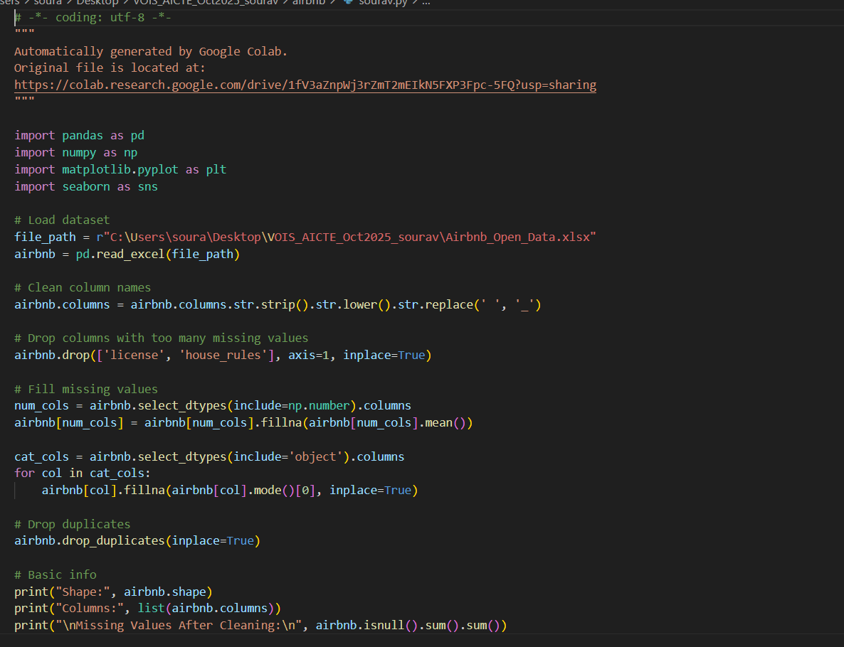
Python code

Slide 7
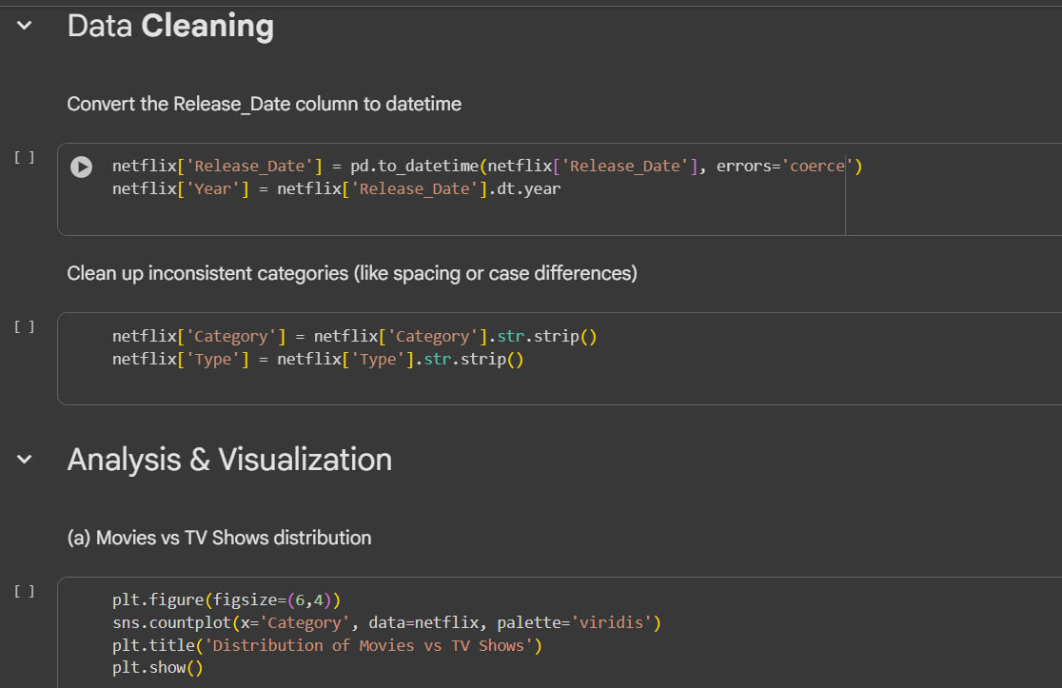
RESULTS1
[Add screen shots of your code or Chart(s) ]

Slide 8
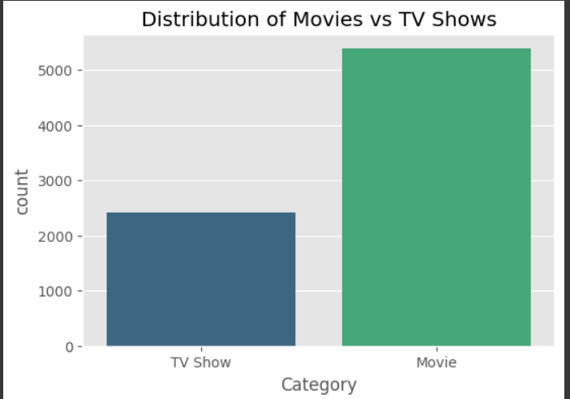
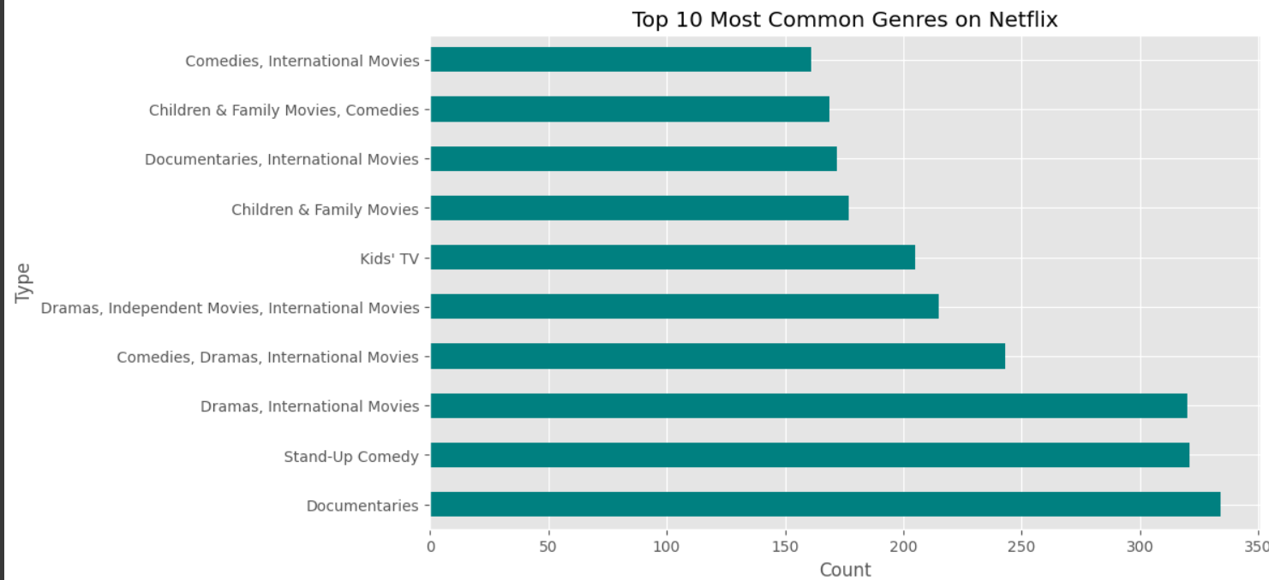
RESULTS2
[Add screen shots of your code or Chart(s) ]

Slide 9
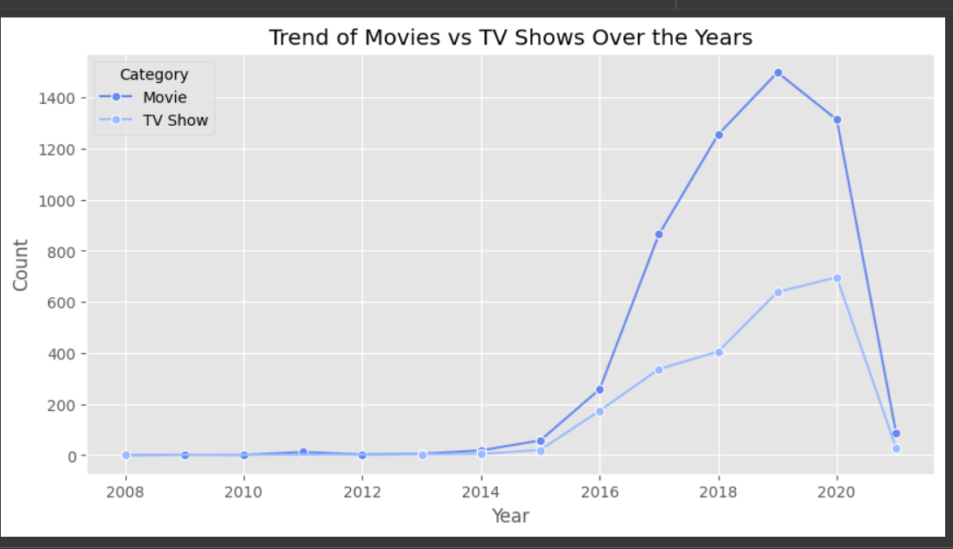
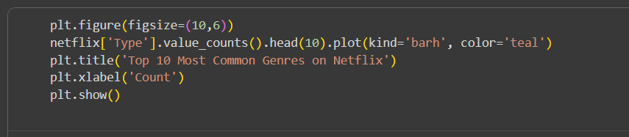
RESULTS3
[Add screen shots of your code or Chart(s) ]

Slide 10
GitHub repository
https://github.com/sourav0190/VOIS_AICTE_Oct2025_MajorProject_SouravThakur.git

Slide 11

Getting started with Basics of Python Certificate

Slide 12

Data Visualization Certificate

Slide 13
Thank you
.
.

